Slide 1
If there is beer…
Will they come?
An analytical dive into the establishment of breweries in Nashville neighborhoods
Nashville Software School
Part-Time Data Analytics Cohort 7
A Capstone Project by Sarah Missimer
Notes:
Hi everyone, my name is Sarah Missimer, I’m in the Nashville Software Schools Data Analytics Cohort 7.
Thank you for coming to my capstone presentation on this lovely Thursday evening.
As a native Nashvillian, I have seen quite a bit of growth over the years.
I have seen areas once known for abandoned buildings and parking lots blossom into beautiful, hip neighborhoods. I have seen neighborhoods on the brink of extinction revitalize into melting pots of food, music and shopping. From when I was young to now, even Broadway has changed its tune.
And one thing I have noticed most about these thriving neighborhoods in Nashville - once I turned 21 and developed a love of craft beer - is: a majority of them have a brewery established within their zip code.
Which led me to this data project. Does the establishment of a craft brewery bring growth to Nashville zip codes?

Slide 2



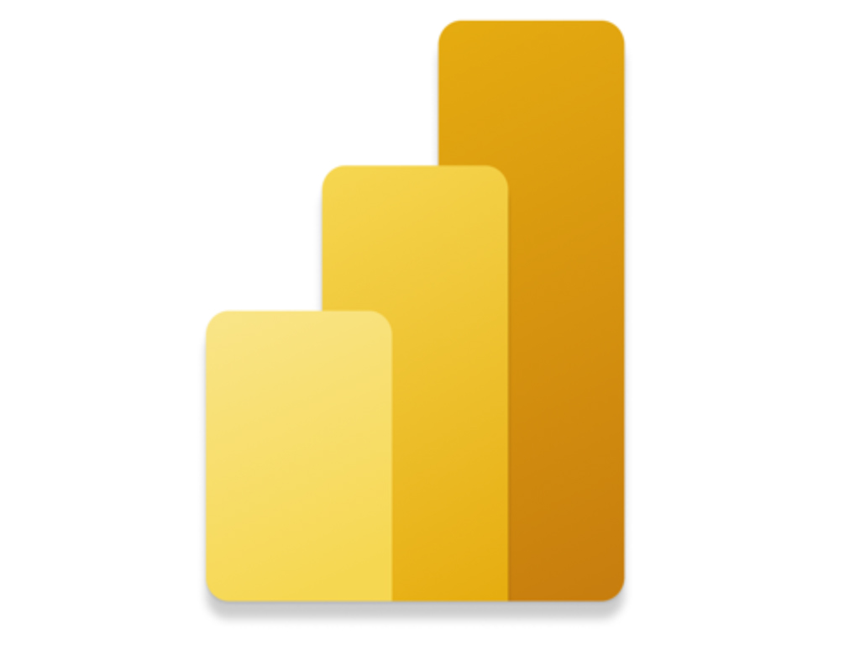

Sources & Technologies
Notes:
United States Census Bureau
Yelp API Business Search
Better Business Bureau: Nashville
Python
Power BI
United State Census Bureau for my population, income and housing value data for each zip code within in Davidson county. I then used the YELP business search API to gather data on breweries located within a 6 mile radius of Nashville’s city proper. Finally, I used the BBB of Nashville to designate when breweries opened. Python was used to gather, clean, organize, and analyze the data I gathered, along with a few visuals. I used Power BI to assist with my analysis and to create a few interactive dashboards that we will dive into later.

Slide 3
Agenda
Define growth
Population detail
Income detail
Housing value detail
Conclusion & Trends
Notes:
Here’s what we’re going to look at this evening.
First, Define what growth means for this analysis.
Then, we will dive into the categories that determined whether there was growth or not.
Lastly, we look at some overall trends seen from the data … to ultimately answer our question. Do breweries bring growth to neighborhoods?

Slide 4
Do breweries bring growth to neighborhoods?
Growth is defined by:
Growth Rate is:
An increase in population
An increase in income
An increase in housing value
The change (either positive or negative) of each category from 2011 to 2020.
Notes:
Growth can mean many things to a number of people.
So, first I want to define what ‘growth’ means for this analysis… along with defining a measurement we are using throughout.
Growth is an increase in population, an increase in income and an increase in housing value within each zip code.
We are also using a growth rate measurement which is the change (positive or negative) of each category from 2011 to 2020.

Slide 5
Population
Notes:
First, we’re going to look at population growth rate between zip codes with breweries and zip codes without.

Slide 6
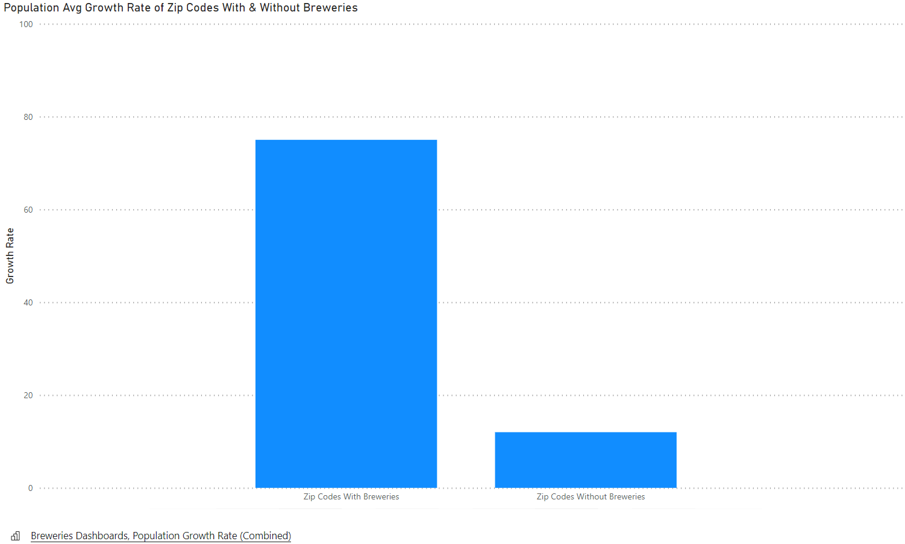
Notes:
The left bar shows the average population growth rate for all zip codes with breweries at around 75% from 2011 to 2020. Compared to zip codes without breweries on the right, which only experienced an average growth rate of about 15% from 2011 to 2020.
Next, I wanted to look at the individual zip codes with breweries to see if there was any common trends shared between zip codes.. Like perhaps how many breweries were in each…

Slide 7
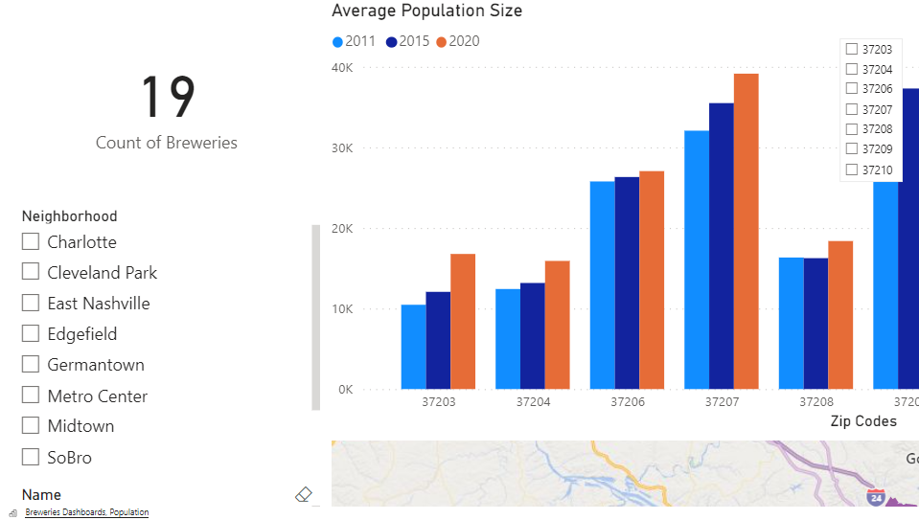
Notes:
Upon first glance, 37207 and 37209 stand out the most. They both have populations reaching close to 40,000 by 2020.
However, it’s 37203 showing the highest growth rate. 60% from 2011 to 2020.
Let’s dive in bit more.
The zip code encompasses three different neighborhoods in Nashville, SoBro, South Nashville and Wedgewood-Houston.. It has a total of 3 breweries as of 2020. When looking at the average population size, you can see the population increased by about 13,000 from 2011 to 2020.
Curious if the number of breweries played a part in the growth, I wanted to look at the second highest zip code..
Let’s look at the second highest, which is 37204. It only has one brewery… with a population increase of about 13,000 as well. Where it defers is in the rate at which it grew, which was only about 28%.
Which did make me wonder, does the number of breweries make a difference for growth?

Slide 8
Income
Notes:
Next, we’re going to look at household income.

Slide 9
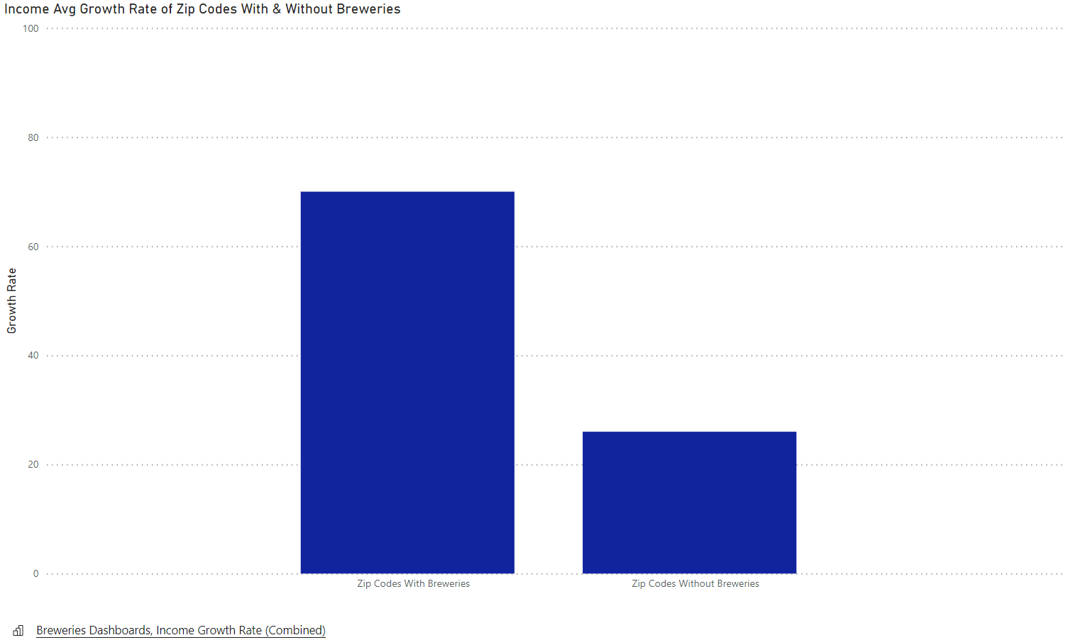
Notes:
Like population growth rate, zip codes with breweries grew by about 75% in household income from 2011 to 2020.
Zip codes without breweries grew by about 30% in household income …
Just as with population, I was curious if there were any common trends among zip codes with breweries…

Slide 10
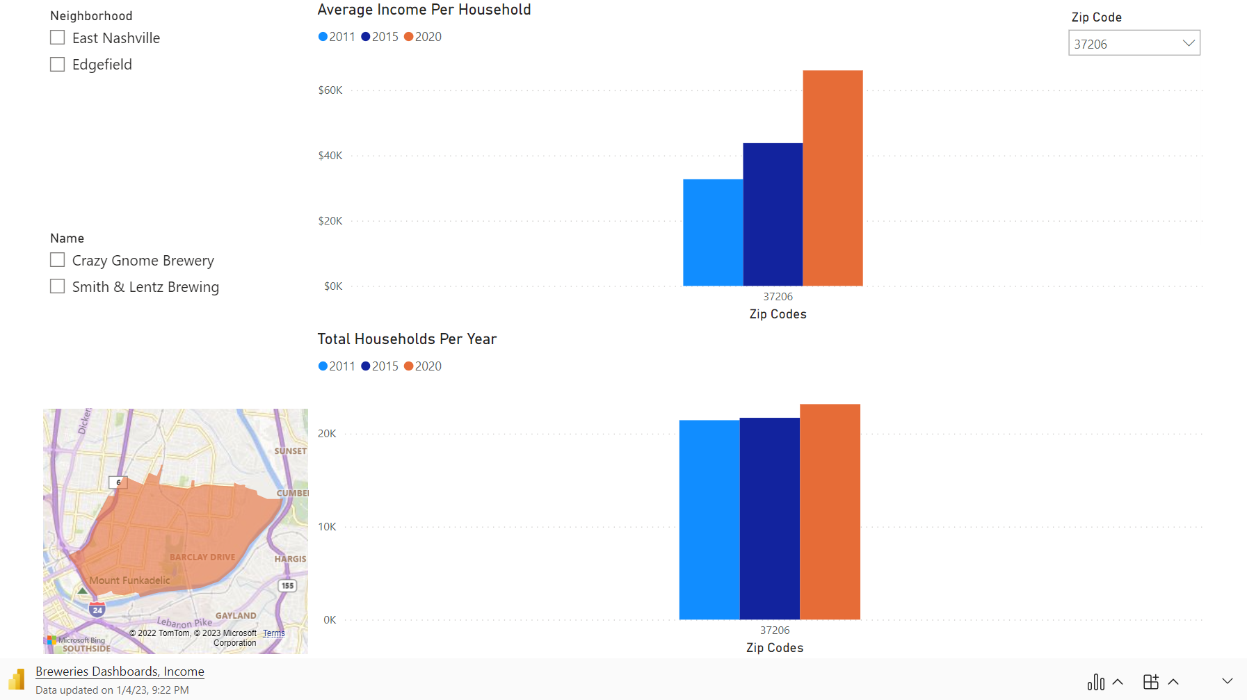
Notes:
The first zip code to stand out is 37203. This should be a familiar zip code as it was also the zip code that experienced the highest population growth rate. From 2011 to 2020, the household income grew by around 120%.
The next zip code is 37208 – which you can see highlighted in pink north of the city. The neighborhoods that make up this zip code are Germantown (along with Salemtown, Buena Vista).. But as far as breweries, you’ll find them in Germantown. Bearded Iris and Monday Night Brewery, so there were two breweries as of 2020 established in this neighborhood. From 2011 to 2020, 37208 grew by around 100%.
The last zip code I want to look at, which also had about 100% growth rate from 2011 to 2020 is 37206. Which you can see highlighted in orange on the map. There are two breweries within this zip code, along with two neighborhoods. East Nashville proper and Edgefield.
All together the 3 zip codes with the highest income growth rate either had multiple neighborhoods within the zip code, or multiple breweries, or both. Let’s look at housing value to see if this trend possibly continues.

Slide 11
Housing Value
Notes:
Lastly, let’s look at housing value…

Slide 12
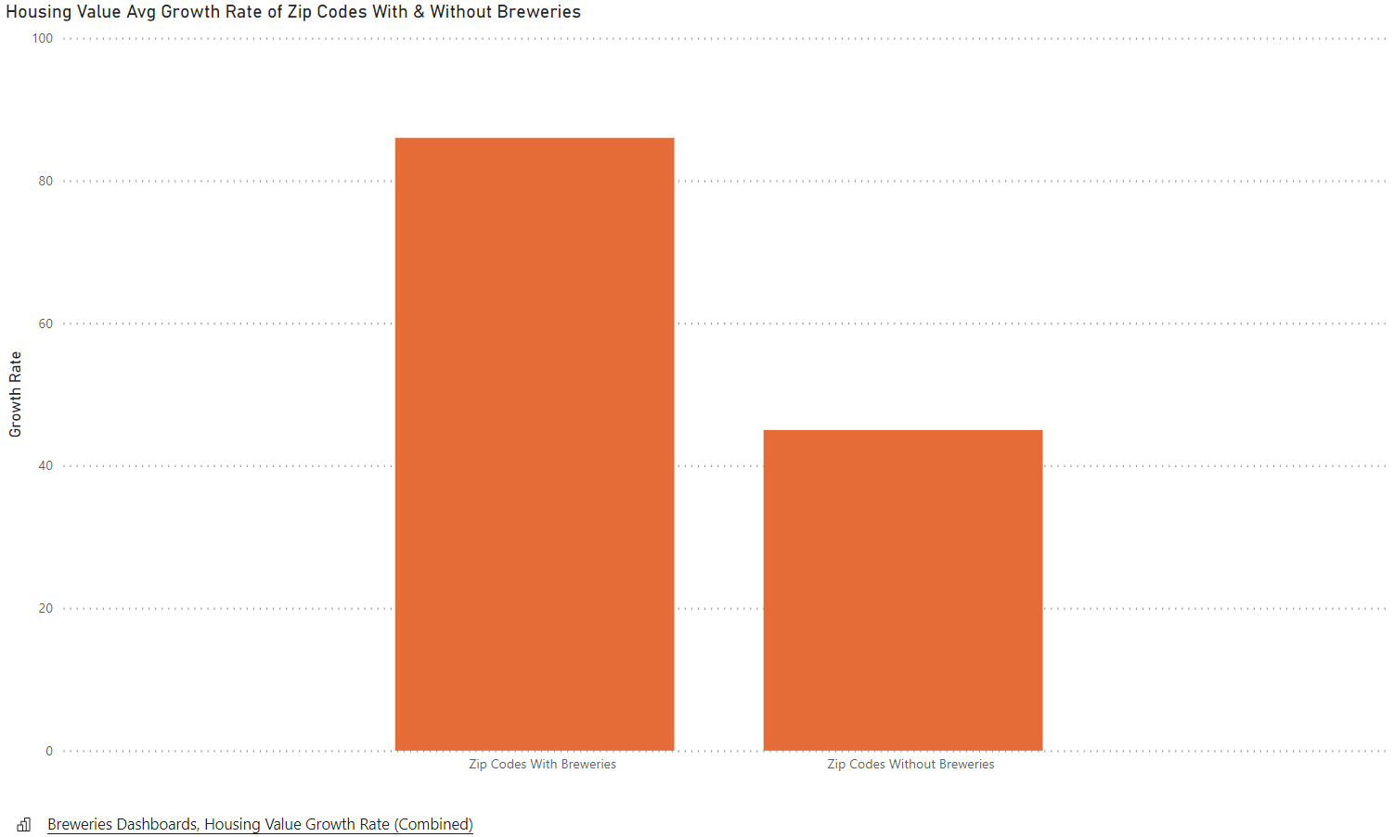
Notes:
Zip codes with breweries grew by about 85% in housing value from 2011 to 2020.
Zip codes without breweries grew by about 45% in housing value…
Housing value was the highest growth rate for both categories… And I was interested to see if zip codes with multiple breweries, multiple neighborhoods, showed the highest growth rate.. The way they had for income and population.

Slide 13
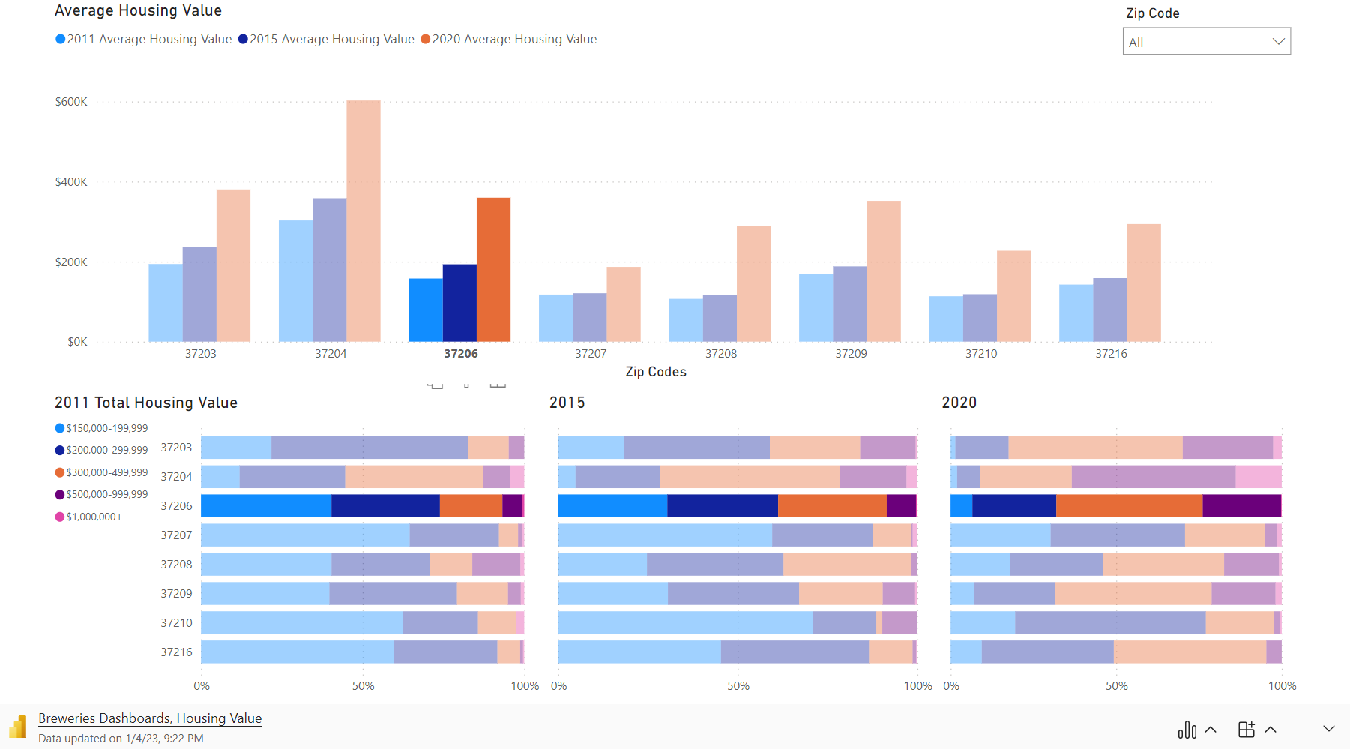
Notes:
Nearly all zip codes with breweries, saw a 100% or more growth in housing value from 2011 – 2020. The highest increase is found in 37208 – which is one of the zip codes that also experienced a high household income growth rate. As a little reminder, the neighborhood we’re referencing is Germantown.
Let’s see how the housing value changed over the span of 9 years for this zip code.
In 2011, nearly 50% of houses valued between 150-200 thousand… by 2015, you see that percentage drop to about 25%. With houses valuing more between 200-500k. By 2020, 500k to nearly 1million dollar homes make up about 15% of the zip code.
Just like in income growth, you see a sharper increase when there’s more than one brewery. Just look at 37206 – our East Nashville and Edgefield neighborhoods - it has two breweries..… it’s housing value increased by 128% from 2011-2020. With an increase in housing value $200k.

Slide 14
Conclusions & Trends
Notes:
Let’s summarize the trends we saw…

Slide 15
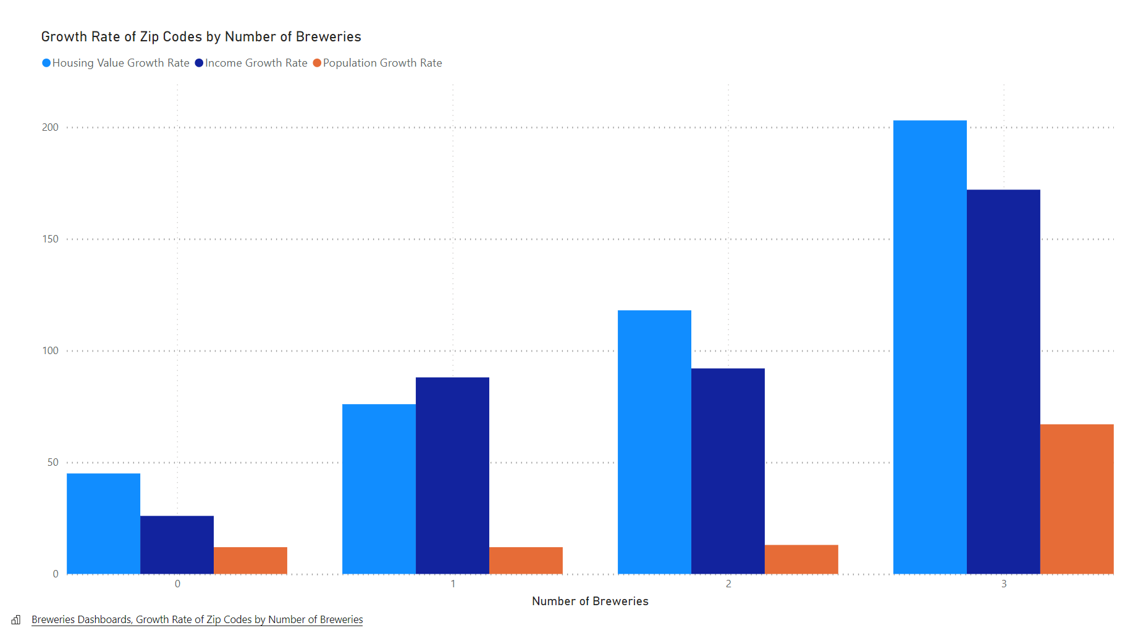
+
Notes:
As the number of breweries increased in each zip code, the income, population and housing value increased as well.
Zip codes with 3 or more breweries had the highest growth rate of each category …
I thought it was interesting that there wasn’t much of a difference between population growth rates of zip codes with only 1 or 2 breweries and zip codes without any breweries. I also thought it was interesting that zip codes with 1 or 2 breweries also shared similar income growth rates.
Concluding for me, 3 or more is the magic number for growth.

Slide 16
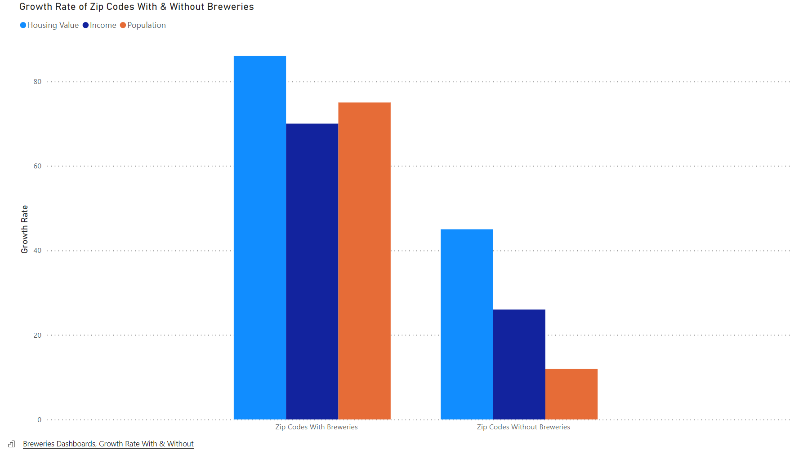
Notes:
Overall, zip codes with breweries did see more growth when compared to zip codes without established breweries.

Slide 17
Conclusions & Trends
As the number of breweries increased in each zip code, the income, population and housing value increased.
Zip codes with 3 or more breweries has the highest growth rate of each category
Zip codes with breweries did see more growth when compared to zip codes without established breweries.

Slide 18
Final Thoughts
External Factors
What’s next for this project?
Overall, growth is happening in Nashville.
From this analysis, breweries tend to establish themselves in up-and-coming neighbors or in more urban areas. People like living in these ‘hip’ city areas.
Income is increasing as larger businesses establish themselves in Nashville.
Housing value is increasing as demand for homes in these zip codes increases.
Expanding the datasets to include more years
  This would help fill in some gaps with the growth metrics and when a brewery established itself in a zip code.
Finding data that shows revenue over the selected years for each brewery
  This would be interesting data to see if there’s a mutually beneficial relationship between neighborhood and brewery.
Notes:
Just a few final thoughts…
I am not overlooking external factors…
What’s next for this project?

Slide 19
Thank You! Questions?

Slide 20
Appendix

Slide 21
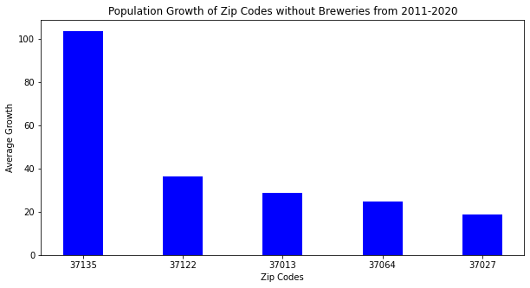
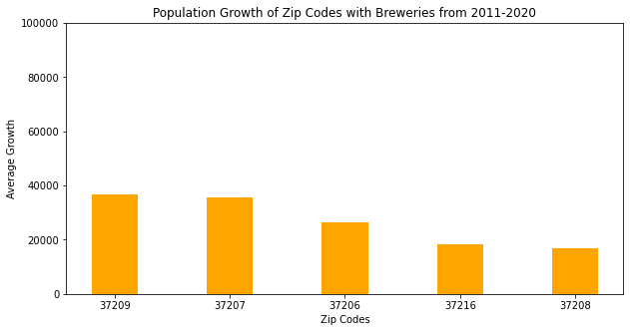
Notes:
When thinking about

Slide 22
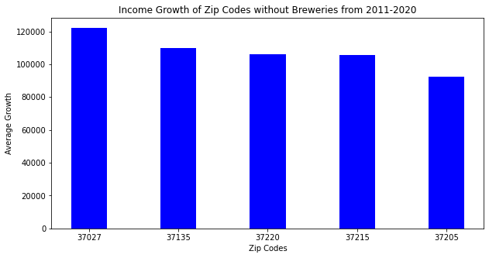
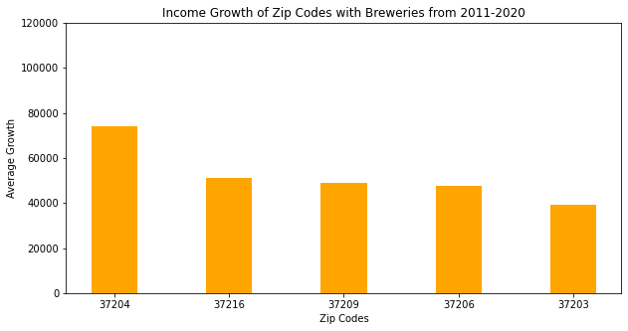

Slide 23
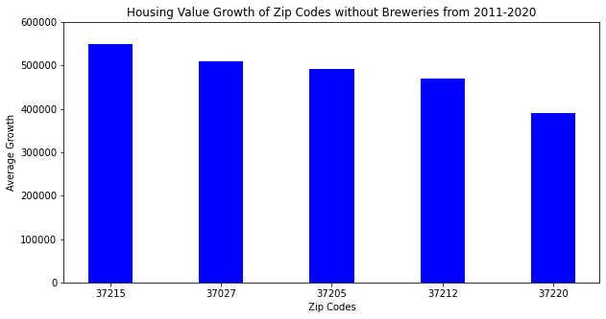
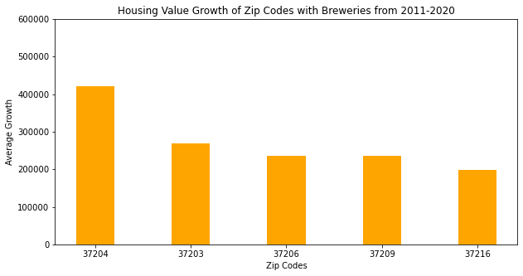

Slide 24
